Slide 1

18CSC202J - OBJECT ORIENTED DESIGN AND PROGRAMMING
ACCESS SPECIFIERS

Slide 2
Access control in classes
public : A public member is accessible from anywhere outside the class but within a program.
private : A private member variable or function cannot be accessed, or even viewed from outside the class. Only the class and friend functions can access private members.
protected : A protected member variable or function is very similar to a private member but it provided one additional benefit that they can be accessed in child classes which are called derived classes
•

Slide 3






Access Specifiers Example 1
#include <iostream> using namespace std;
class Line
{
public:
double length;
void setLength( double len ); double getLength( void );
};
double Line::getLength(void)
{
return length ;
}
void Line::setLength( double len )
{
length = len;
}
// Main function for the program
int main( )
{
Line line;
// set line length line.setLength(6.0);
cout << "Length of line : " << line.getLength() <<endl;
// set line length without member function
line.length = 10.0; // OK: because length is public cout << "Length of line : " << line.length <<endl; return 0;
}
Length of line : 6 Length of line : 10

Slide 4






Access Specifiers Example 2
#include <iostream>
using namespace std; class Box
{
public:
double length;
void setWidth( double wid ); double getWidth( void );
private:
double width;
};
// Member functions definitions double Box::getWidth(void)
{
return width ;
}
void Box::setWidth( double wid )
{
width = wid;
}
// Main function for the program int main( )
{
Box box;
// set box length without member function box.length = 10.0; // OK: because length is public cout << "Length of box : " << box.length <<endl;
// set box width without member function
// box.width = 10.0; // Error: because width is private box.setWidth(10.0); // Use member function to set it. cout << "Width of box : " << box.getWidth() <<endl;
return 0;
}
Length of box : 10 Width of box : 10

Slide 5




Access Specifiers Example 3
#include <iostream> using namespace std;
class Box
{
protected: double width;
};
class SmallBox:Box
{
public:
void setSmallWidth( double wid ); double getSmallWidth( void );
};
// Member functions of child class double SmallBox::getSmallWidth(void)
{
return width ;
}
void SmallBox::setSmallWidth( double wid )
{
width = wid;
}
// Main function for the program int main( )
{
SmallBox box;
// set box width using member function box.setSmallWidth(5.0);
cout << "Width of box : "<< box.getSmallWidth();
return 0;
}
Width of box : 5

Slide 6
Friend function
A friend function of a class is defined outside that class' scope but it has the right to access all private and protected members of the class.
Even though the prototypes for friend functions appear in the class definition, friends are not member functions.
A friend can be a function, function template, or member function, or a class or class template, in which case the entire class and all of its members are friends.

Slide 7
Friend function Example
#include <iostream>
using namespace std;
class XYZ
{
private: int num=100;
char ch='Z';
public: friend void disp(XYZ obj);
};
//Global Function
void disp(XYZ obj)
{
cout<<obj.num<<endl;
cout<<obj.ch<<endl;
}
int main()
{
XYZ obj;
disp(obj);
return 0;
}

Slide 8
Inline Function
C++ provides an inline functions to reduce the function call overhead.
Inline function is a function that is expanded in line when it is called.
When the inline function is called whole code of the inline function gets inserted or substituted at the point of inline function call. This substitution is performed by the C++ compiler at compile time.
Inline function may increase efficiency if it is small.

Slide 9
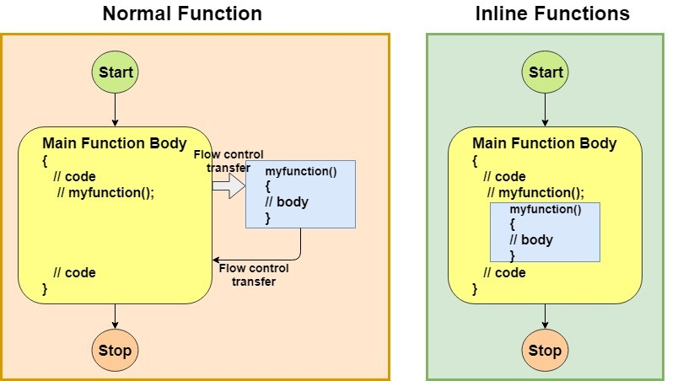
Inline Function - Example

Slide 10
Inline Function - Example
include <iostream>
using namespace std;
inline int Max(int x, int y) {
return (x > y)? x : y;
}
// Main function for the program
int main() {
cout << "Max (20,10): " << Max(20,10) << endl;
cout << "Max (0,200): " << Max(0,200) << endl;
cout << "Max (100,1010): " << Max(100,1010) << endl;
return 0;
}
Output:
Max (20,10): 20
Max (0,200): 200
Max (100,1010): 1010

Slide 11


